Slide 1
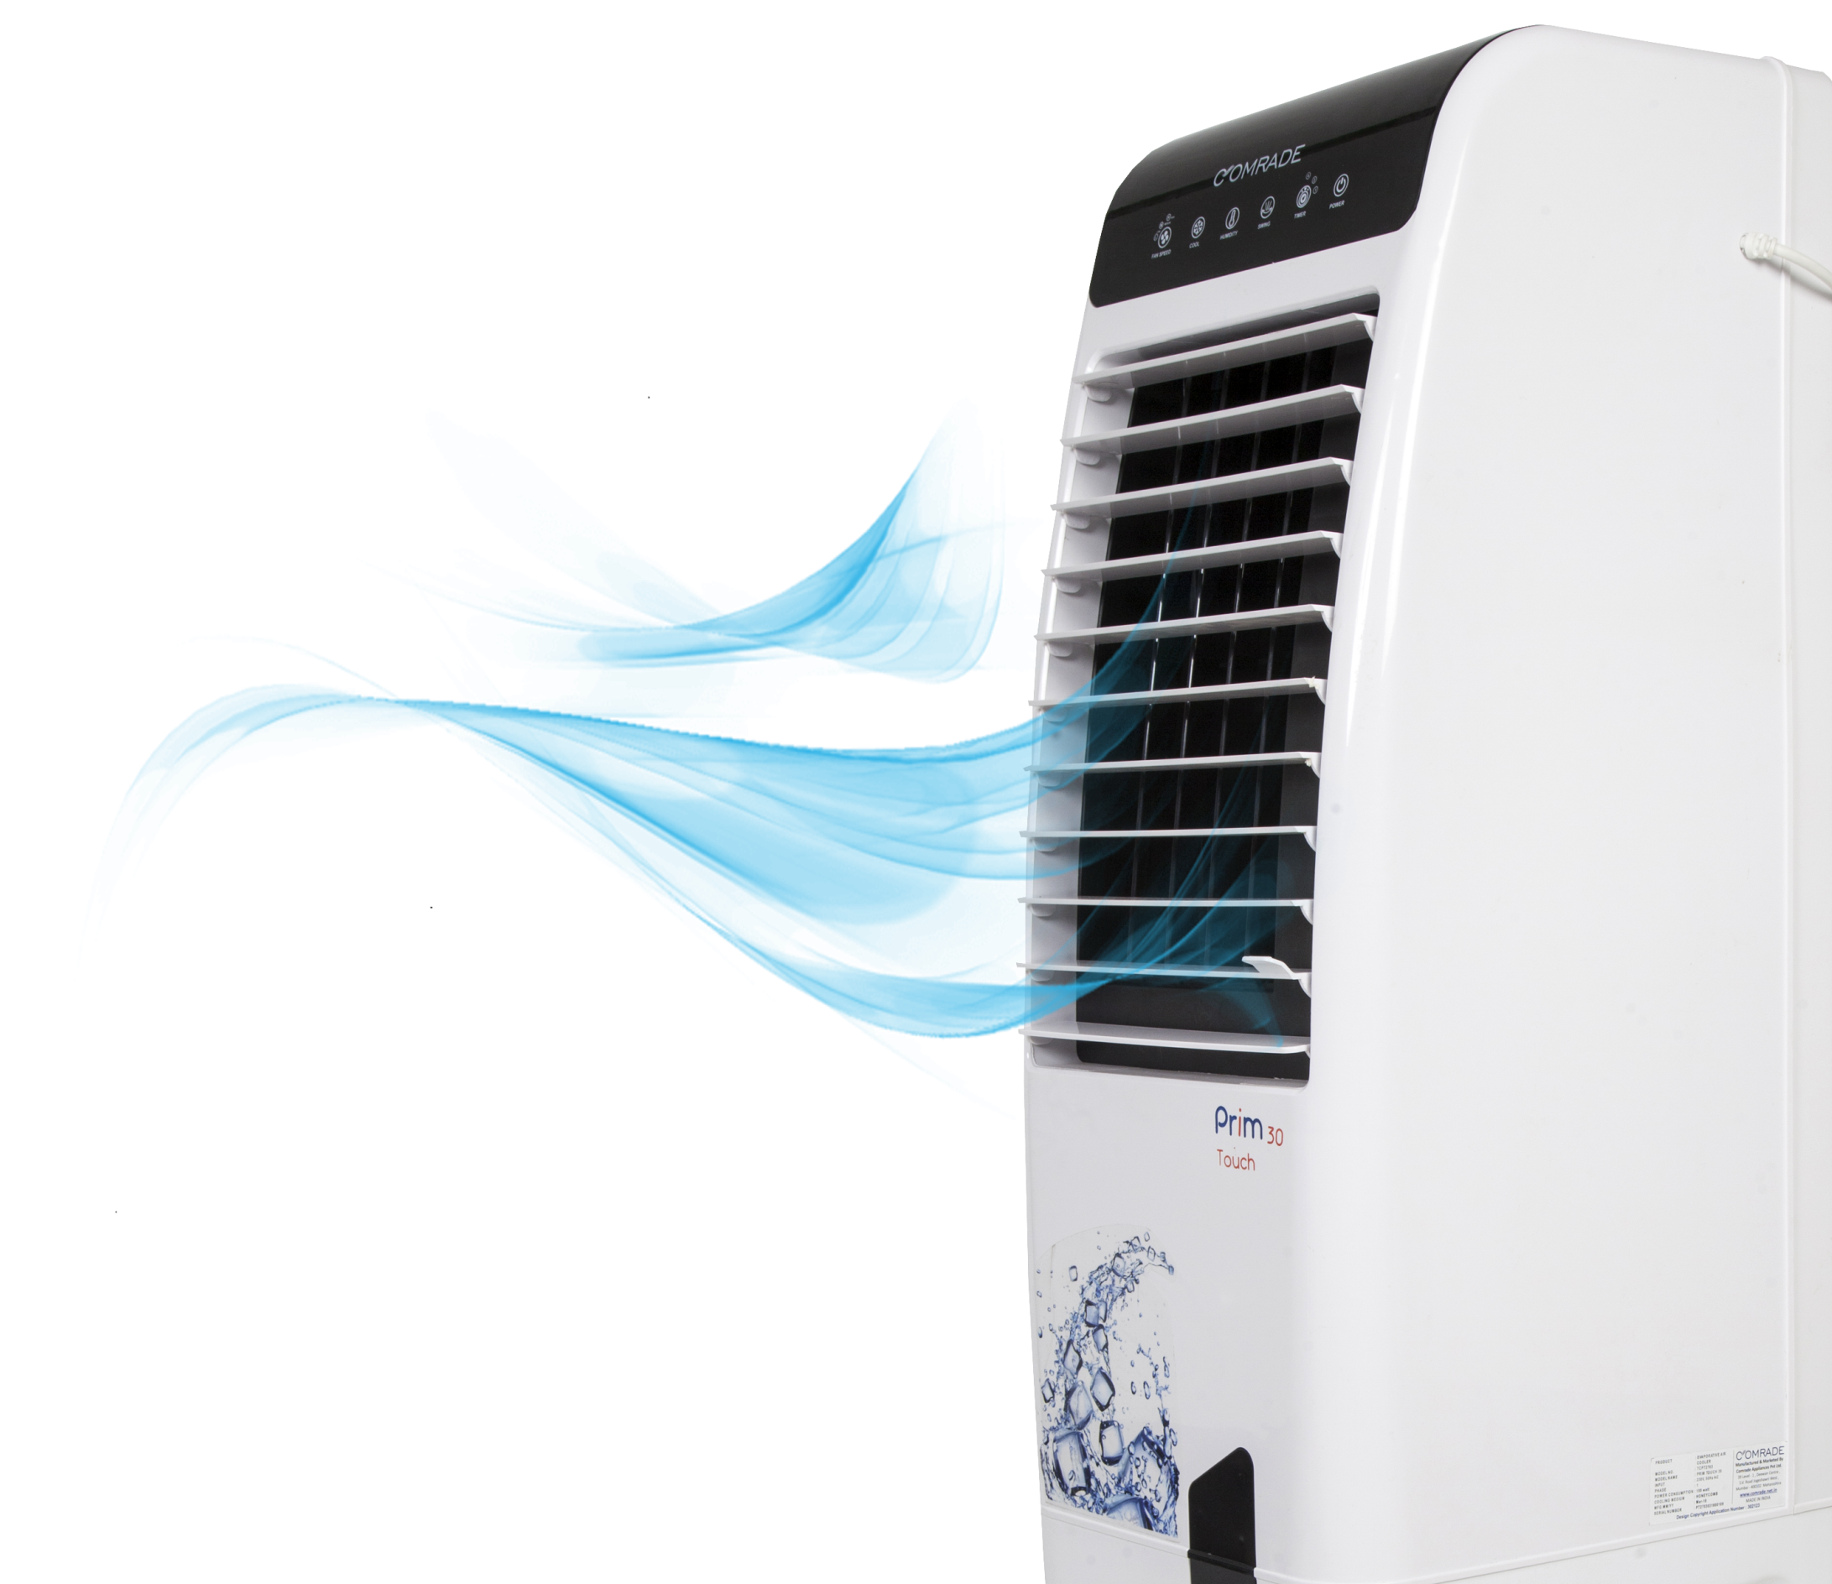
ENTER

Slide 2
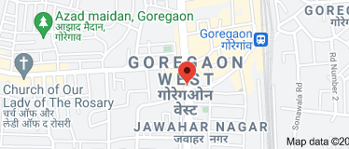
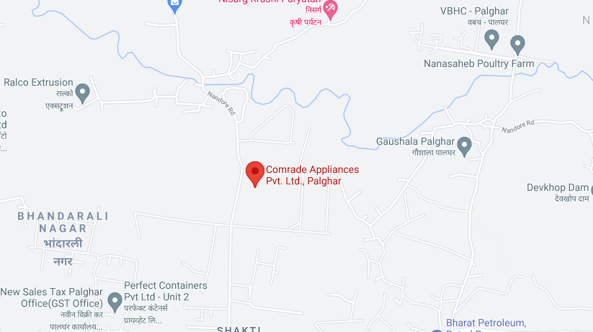
About Us
HEAD OFFICE
39, Level -1, Deewan Centre, S.V. Road, Jogeshwari West,
Mumbai - 400 102 Contact : 022 26774523, Email : info@comrade.net.in
FACTORY
Survey No. 365, Nandore Village , Nandore Road,
Palghar East, Dist Palghar, Maharashtra – 400 102
Website: www.comrade.net.in

Slide 3
CIN No. U74999MH2017PTC292817.
PAN NO. AAGCC9056P
GST No. 27AAGCC9056P1ZX
MSME No. UDYAM-MH-18-0010912
Factory License no: 129002790000000
Certified from Maharashtra Pollution Control Board
Website: www.comrade.net.in

Slide 4
About Us
Established in year 2017.
We Comrade Appliances Private Limited started in the years 2017, are one of the foremost manufacturers and exporters an extensive array of Air Coolers and Geysers. Designed by the use of excellent quality resources, these are available in several specifications as per the exact requirements of our customers. Our product range is appreciated by our customers owing to their lightweight, easy to use, customized size, reasonable price and long-term durability.
We work with extreme enthusiasm and assure to accomplish great customer satisfaction by offering a high-quality range of Air coolers and Geyser as per their specific needs. In order to convene the accurate needs of clients in the most flourishing way, we offer our products with standard and customized specifications. Backed by a team of experienced staff, we have been able to meet the precise needs of our clients. Owing to our ethical business policies, high-quality products range and reasonable prices, we have increased the number of our satisfied clients.
Under the headship of our mentor Mr. Khursheed Alam, our organization is moving ahead in this cutting-edge competition. He, with his knowledge and expertise, has enabled us to cater the demands of customers.

Slide 5
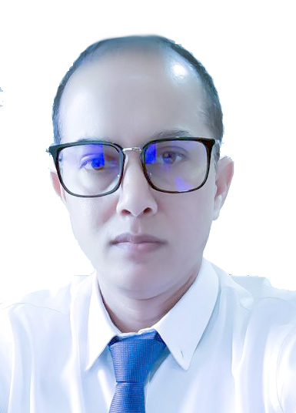
Promoter
Ex- Indian Navy soldier, worked 15 years in Indian Navy in Finance and Administration Department & 09 years experience in business as Director.
Holding MA, MBA Degree and special course of material Management degree.
KHURSHEED ALAM Managing Director
Started with small shop supplying tools for jewelry and Diamond Industry 22 years back in Bangkok. Now the largest and top most supplier of tools and equipment of jewelry and diamond industry in Bangkok in the name of World Jewelry Tools co., Ltd.
Owner of SmartPro Instrument Co., manufacturing first Diamond tester with digital display.
MEHBOOB ALAM Director
___

Slide 6
Vision & Mission
Our vision is to provide the highest quality end products to our customers. Our mission is to provide the market with an high quality products at affordable rate & shall guarantee our customers ultimate satisfaction & create long term relationship with the clients .
Values Statement: We will…
Act with honesty and integrity
Treat people with respect
Conduct all business lawfully
Accept individual and corporate responsibility
Strive for customer satisfaction
Improve and innovate continuously
Never be wasteful
Always work effectively and efficiently

Slide 7
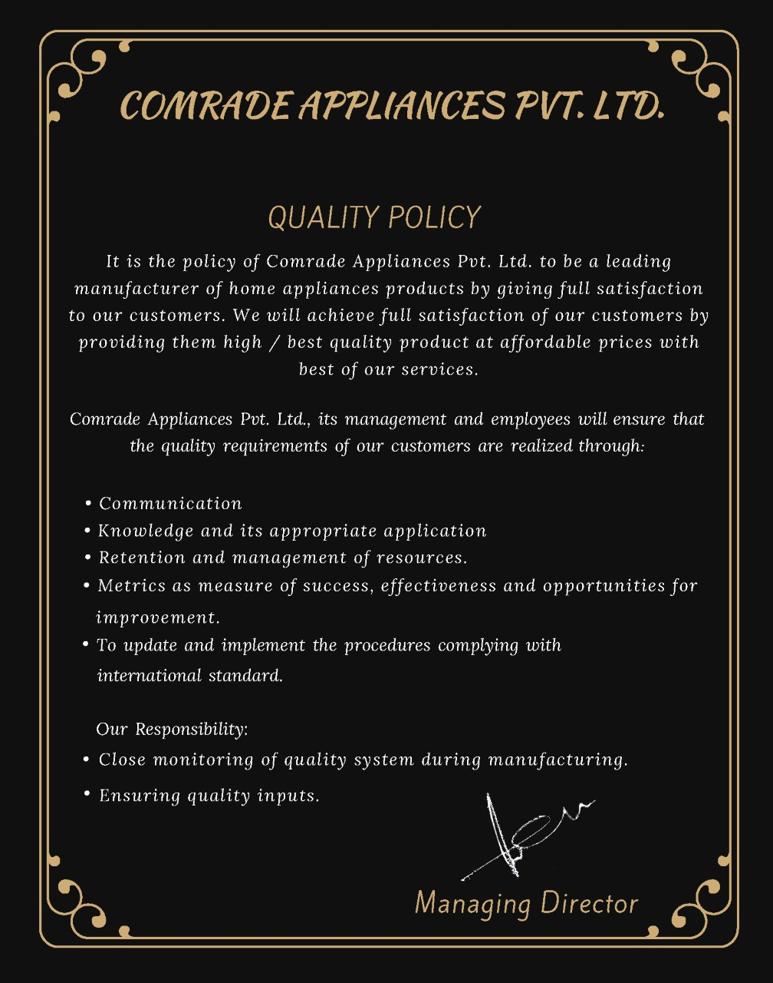
Quality Policy

Slide 8
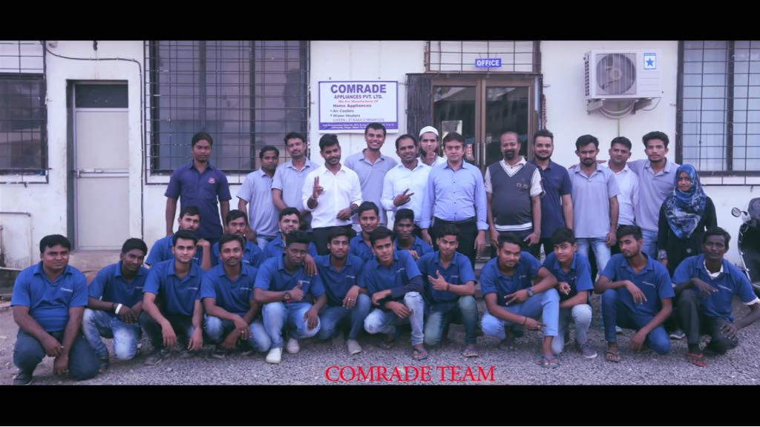
Team
We are assisted by a highly dedicated and efficient team of professionals, well versed with the technicalities of their areas of specialization, they are capable to meet the exact demands of our clients.
They hold immense knowledge about our products. Our greatest strength lies in our human resource that comprises a team of highly dedicated Professionals driven by a single-minded passion for achieving excellence in their field of their expertise.
Supportive staff, managers and skilled employees all together make a number of 100+ members team.

Slide 9
Organisation Chart
Managing Director
General Manager
Production Head
Cooler /Geyser
Admin Head
Logistics
QC Head
Admin Executive
Dispatch
Purchase dept
Finance /System Administrator Manager
Regional Sales Manager
Production Supervisor
Production Team
Asst QC Manager 1
Molding /Motor Production
Account Dept
Sales ASM
Customer Care Dept
HR Dept
Overseas /online Sales purchase
OEM Sales
Asst QC Manager 2
Accounts Executive
Security Head

Slide 10
Achievements
We started our journey in the end of year 2017, and within short time of four years we got tremendous support from our valuable OEM customers, our sales turnover rapidly increasing year & year despite the pandemic situation in two years out of our four year journey.
Expecting the 100 Cr turnover soon with the support of our valuable existing and new OEM customers,
31.04 Cr
25.49 Cr
0.67 Cr
7.93 Cr

Slide 11
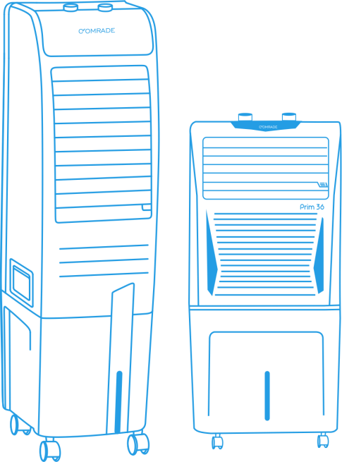
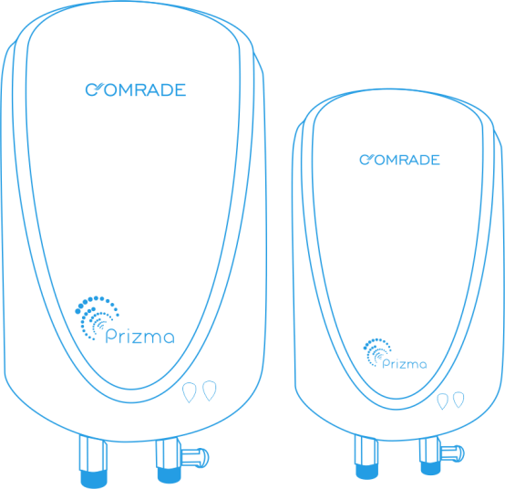
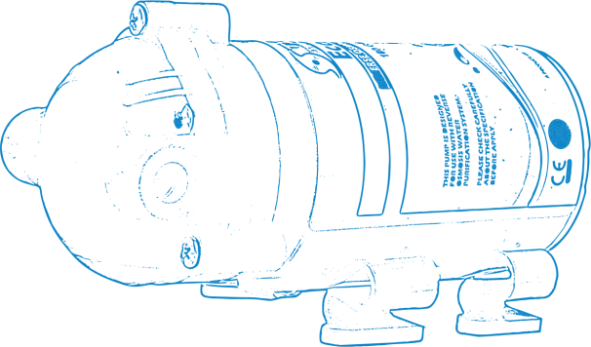
Product Range
Our product range
Air Coolers
Water Heater
RO BOOSTER PUMP
Air Cooler
Water Heaters
RO Booster Pump

Slide 12
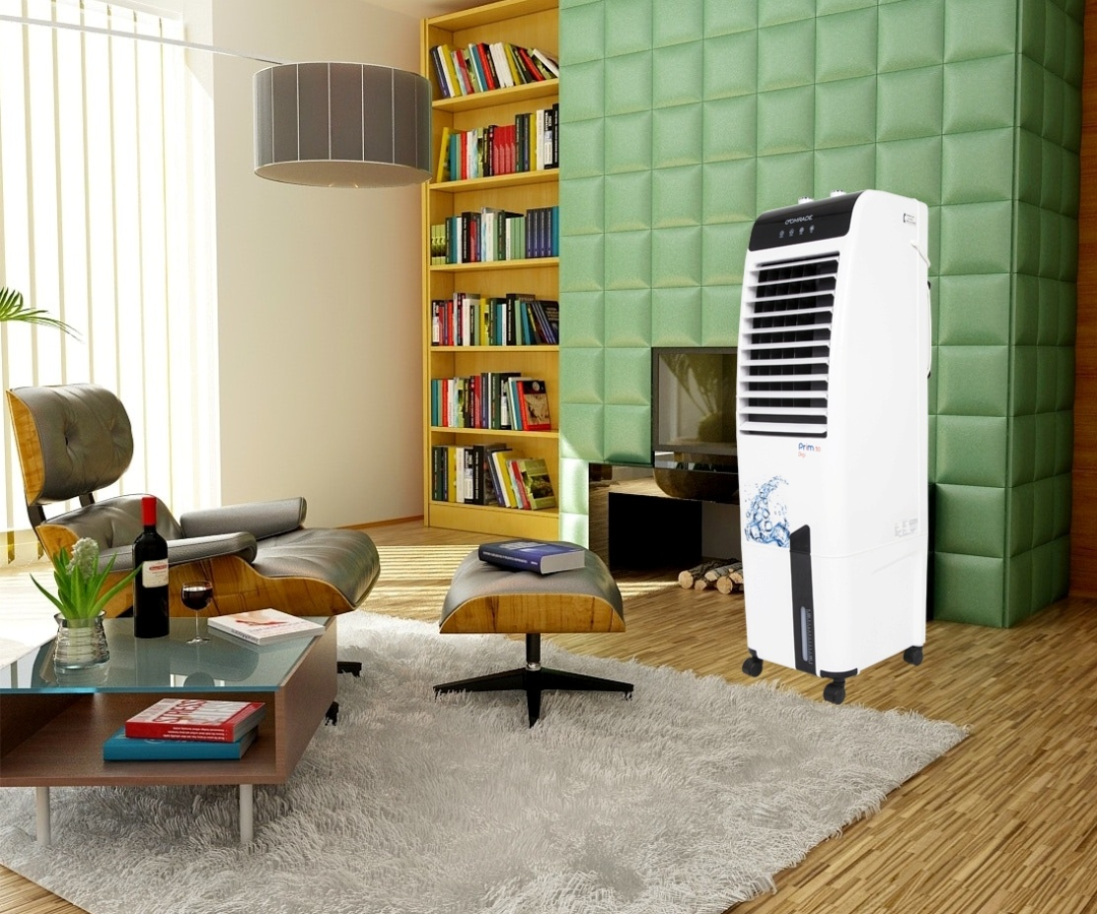
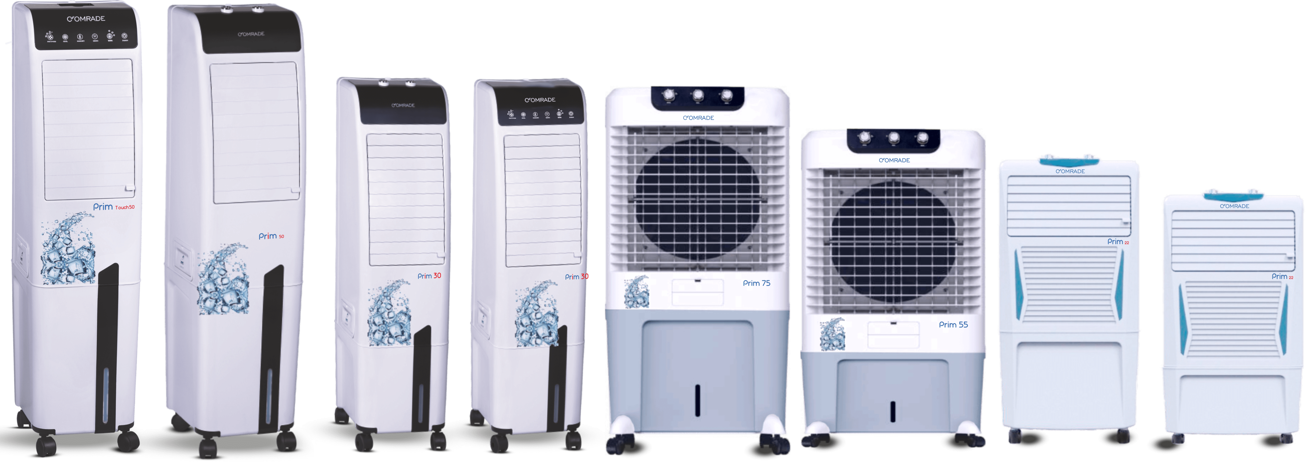
Air Cooler
We have various verity in Air Cooler
Tower Air Cooler
Desert Air Cooler
Personal Air Cooler
BACK TO
PROUCT RANGE

Slide 13
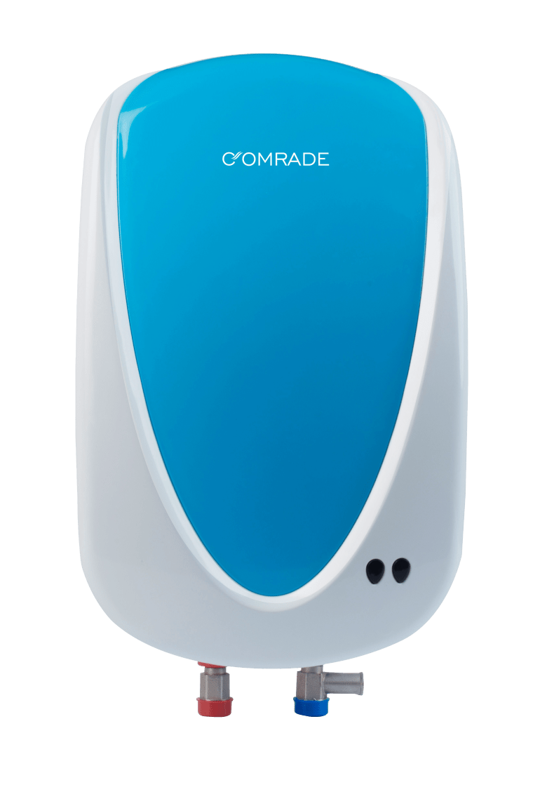
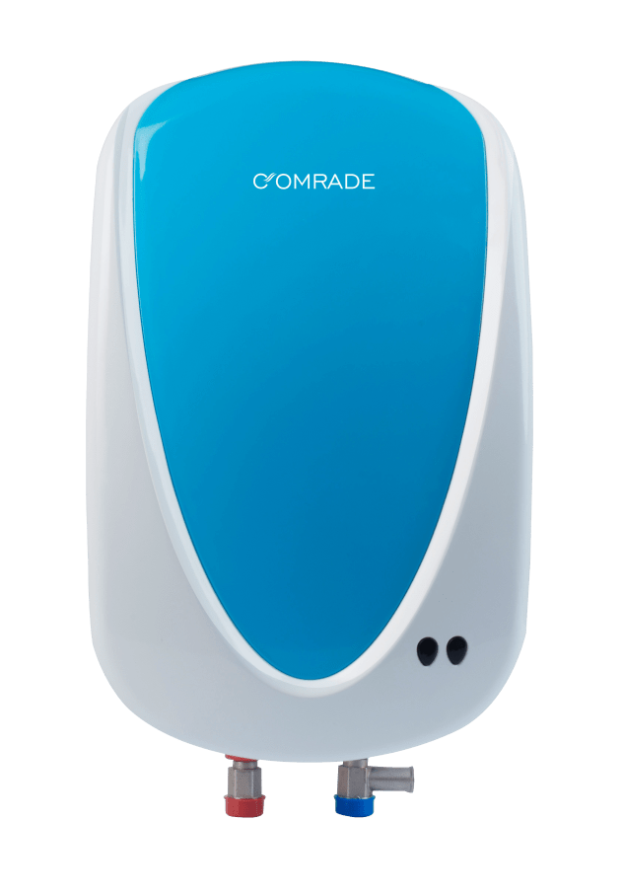
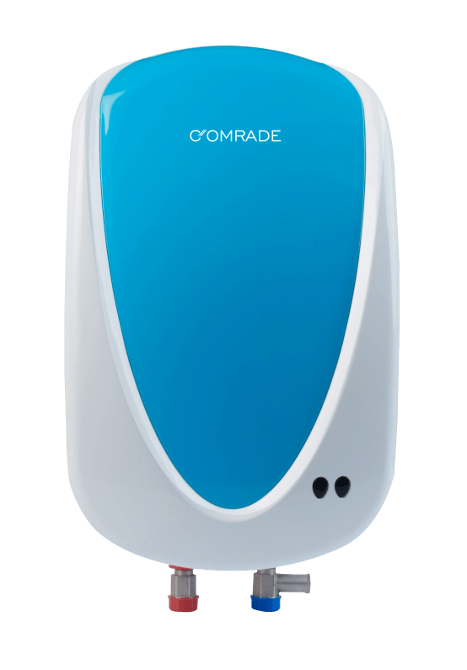
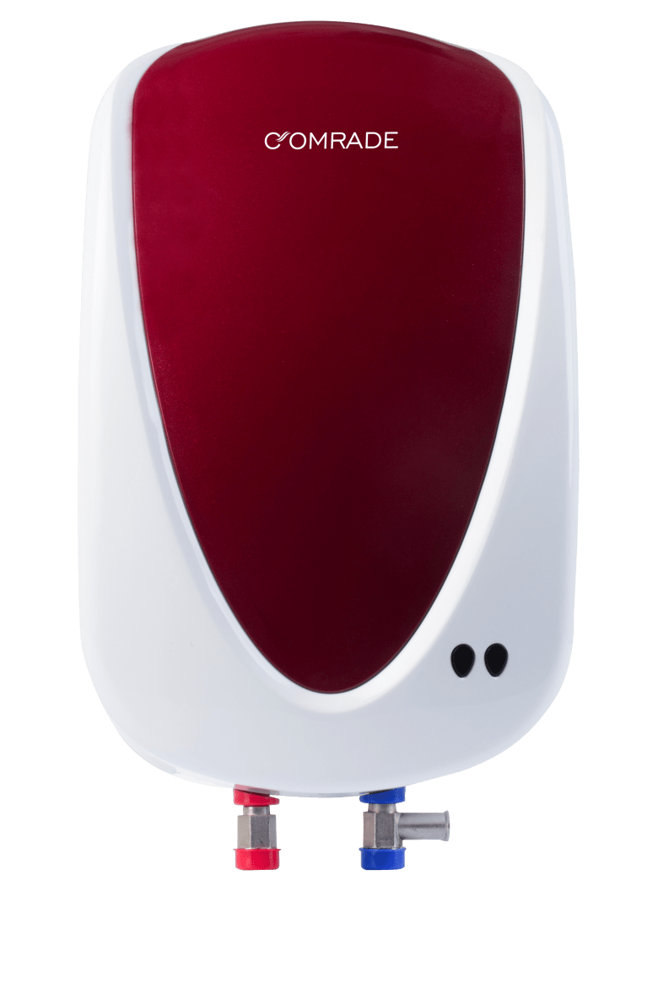
Water Heater
Water Heater Range
Available in 1, 3 & 5 Ltr (4.5 KW/ 3 KW) , Red / Blue Color
BACK TO
PROUCT RANGE

Slide 14
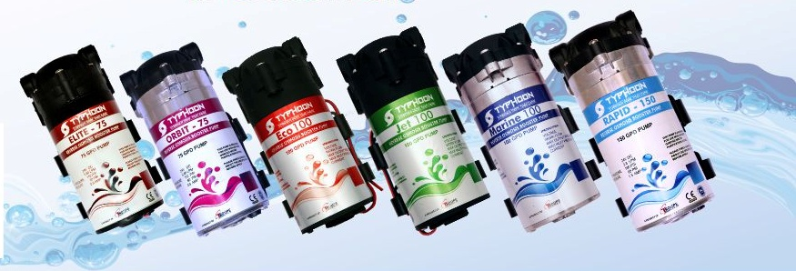
RO BOOSTER PUMP
RO Booster pump use in RO Water purifier
We have wide range of RO Booster Pump which use for commercial & Domestic Use
75/100 / 150 GPD
Booster Pump
BACK TO
PROUCT RANGE

Slide 15
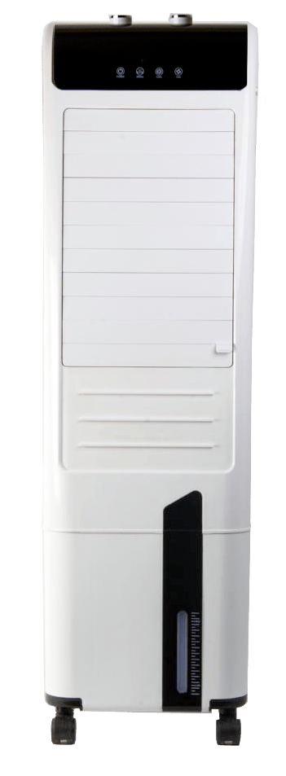
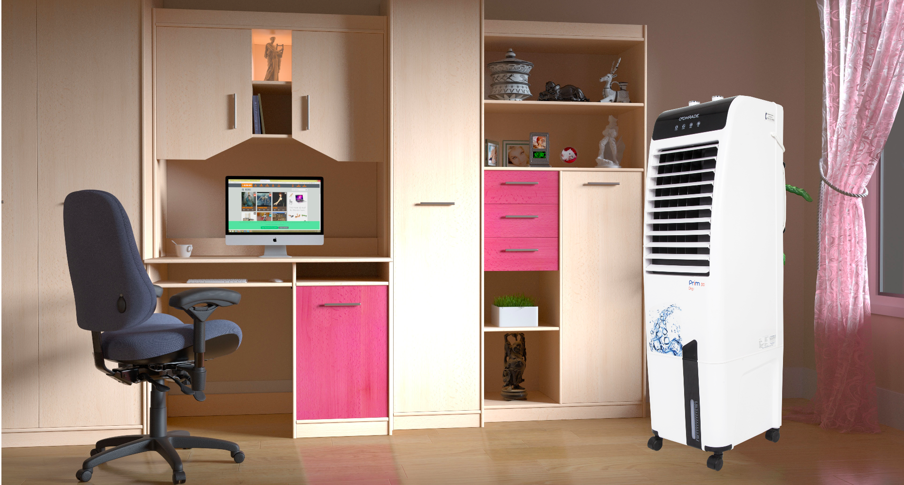
OEM Tower Air Cooler
OEM product range
Tower Cooler
Touch model
Cap : 27 Ltr /47 Ltr
Tower Cooler
Digital Display model
Cap : 27 Ltr /47 Ltr
Tower Cooler
Mechanical model
Cap : 27 Ltr /47 Ltr
BACK TO
PROUCT RANGE

Slide 16
OEM Tower Air Cooler
OEM product range
Tower Cooler
Touch model
Cap : 27 Ltr /47 Ltr
Tower Cooler
Digital Display model
Cap : 27 Ltr /47 Ltr
Tower Cooler
Mechanical model
Cap : 27 Ltr /47 Ltr
BACK TO
PROUCT RANGE

Slide 17
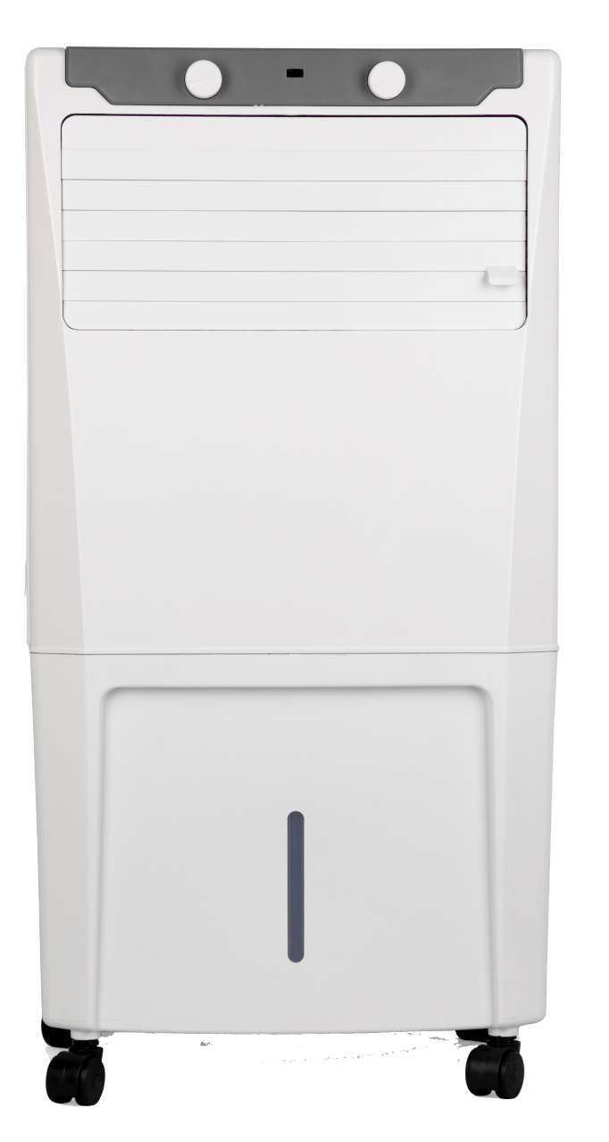
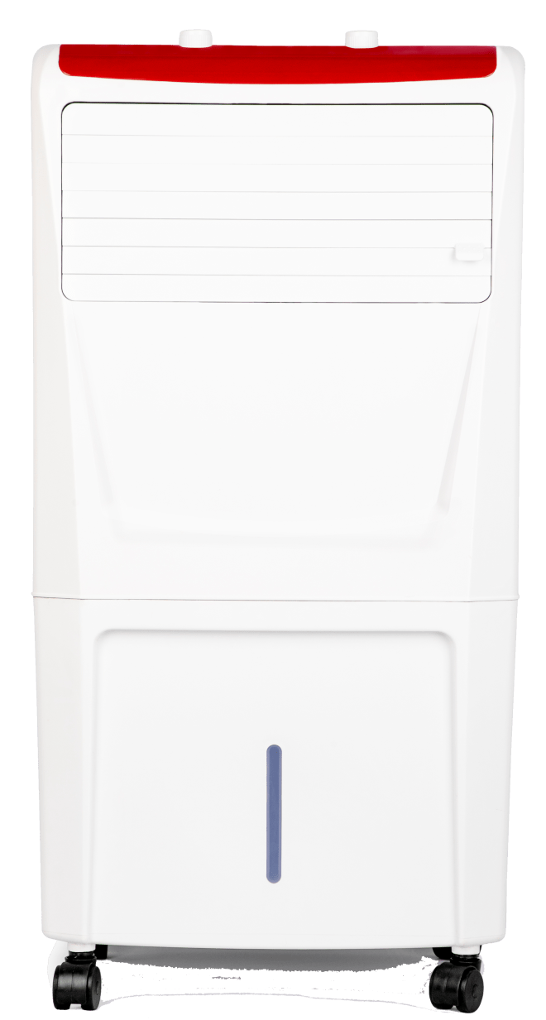
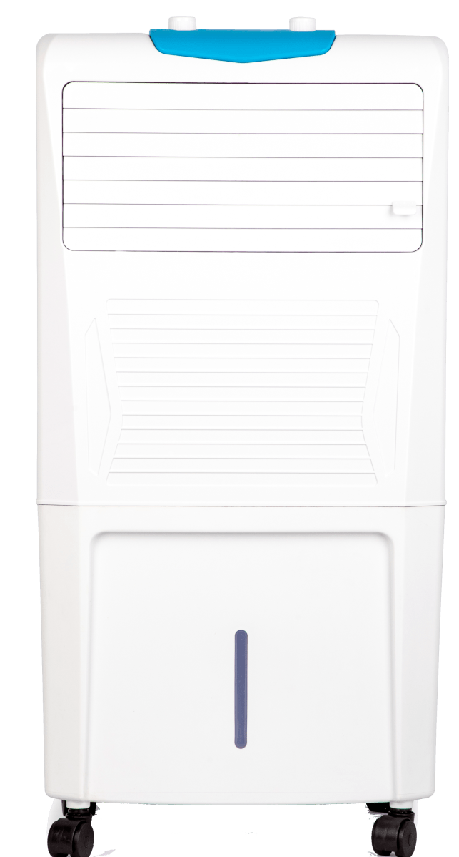
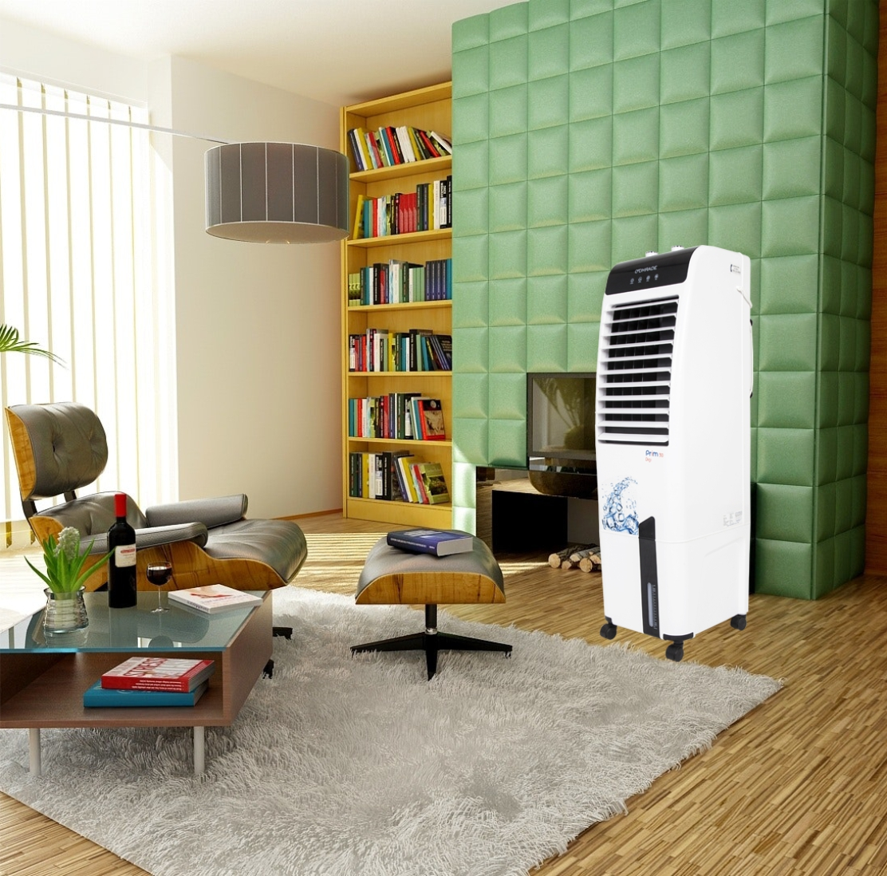
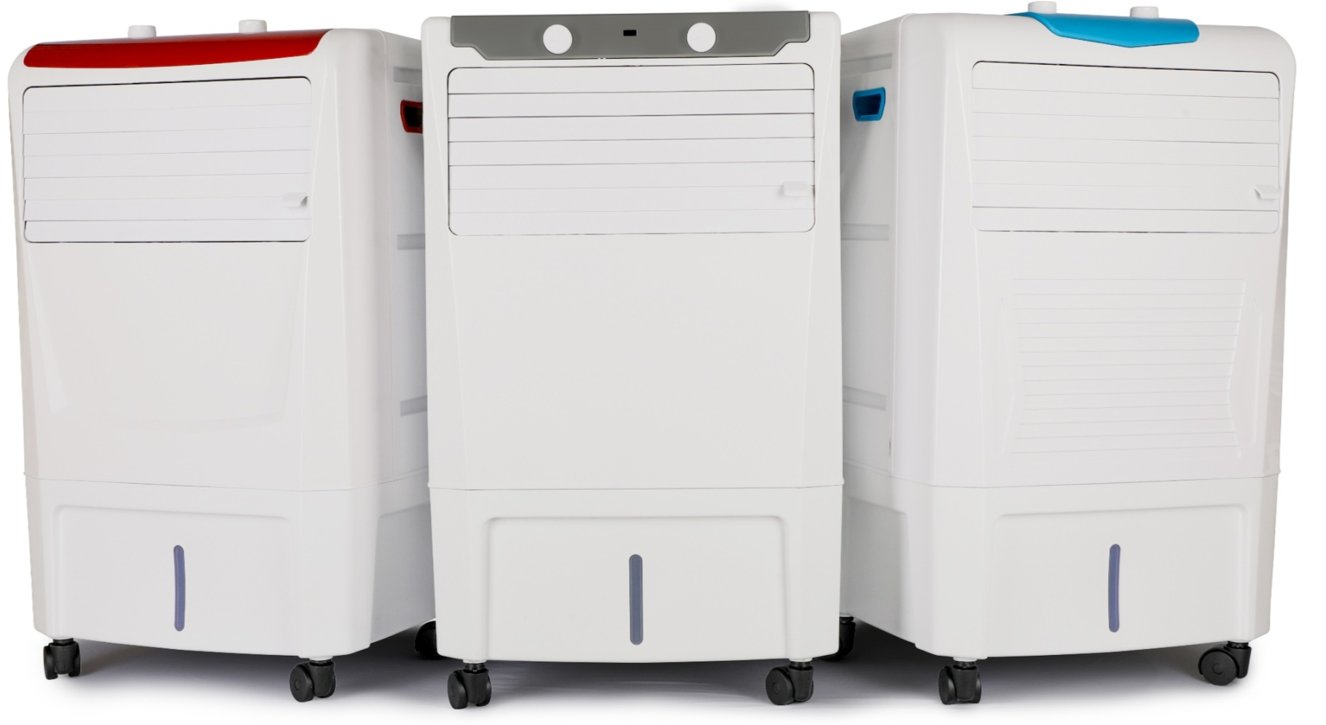
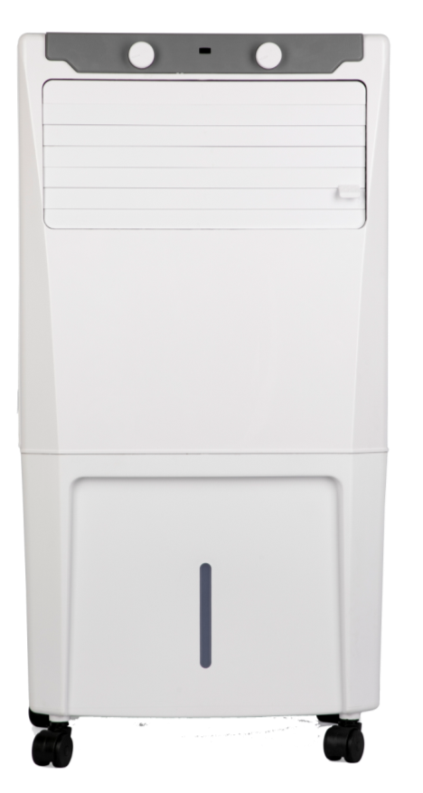
OEM Personal Air Cooler
OEM Product range
Personal Cooler Mechanical model
Cap : 22 Ltr /36 Ltr
BACK TO
PROUCT RANGE

Slide 18
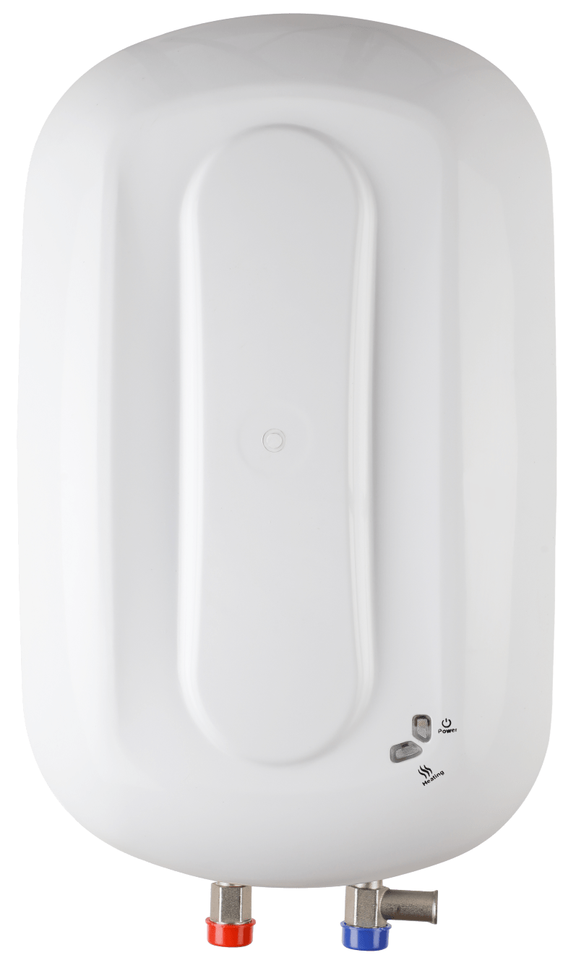
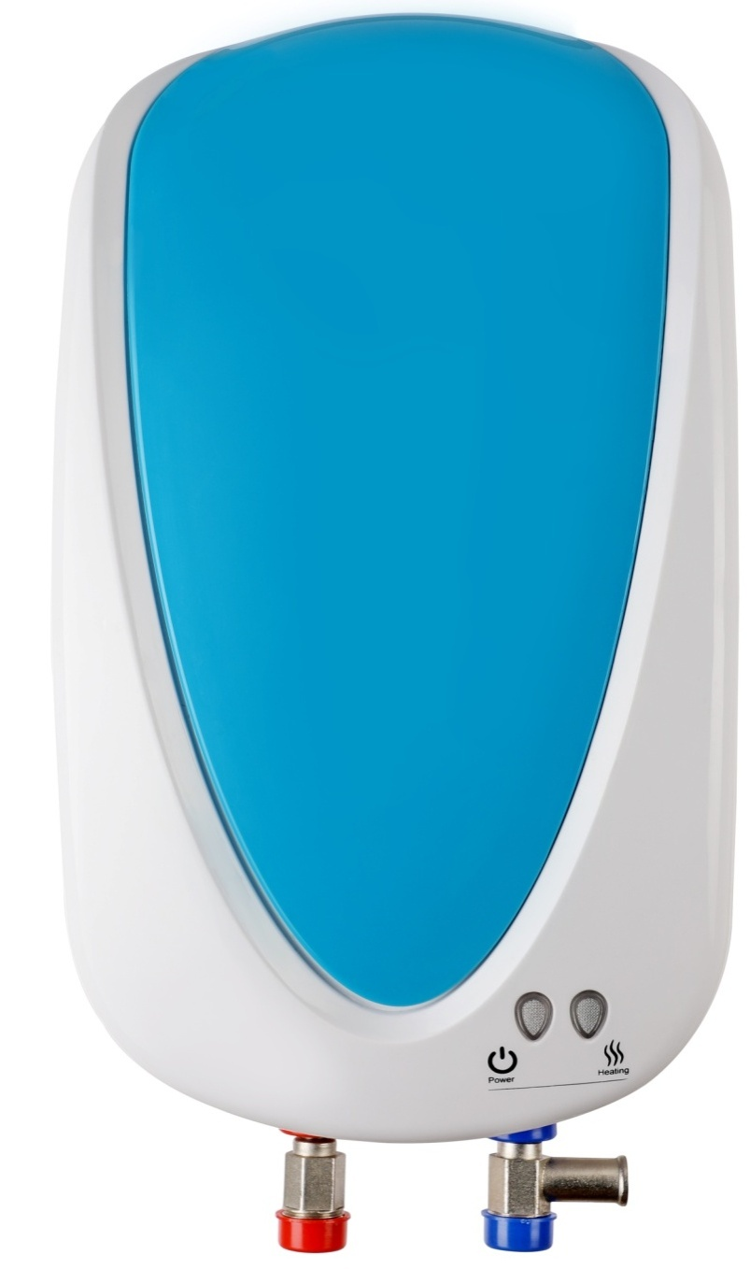
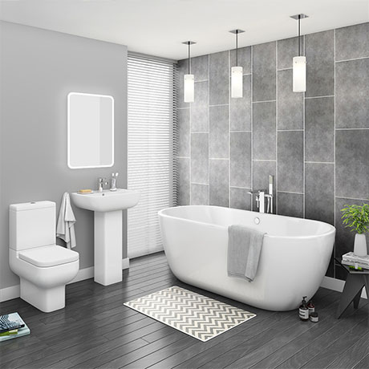
OEM Water Heater
OEM product range
Capacity : 1Ltr /3 Ltr/5 Ltr
KW: 3.5/4.5
BACK TO
PROUCT RANGE

Slide 19
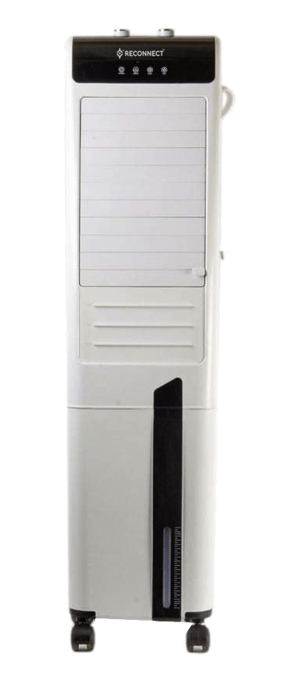
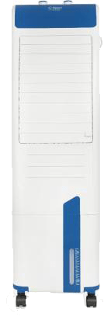
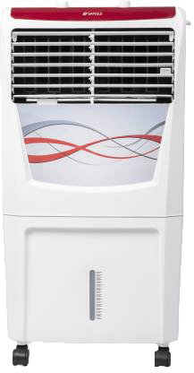
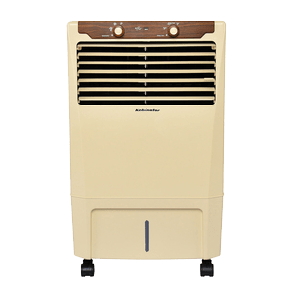
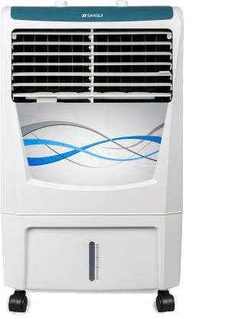
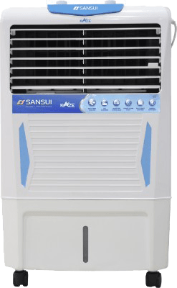
OEM Showcase
BACK TO
PROUCT RANGE

Slide 20
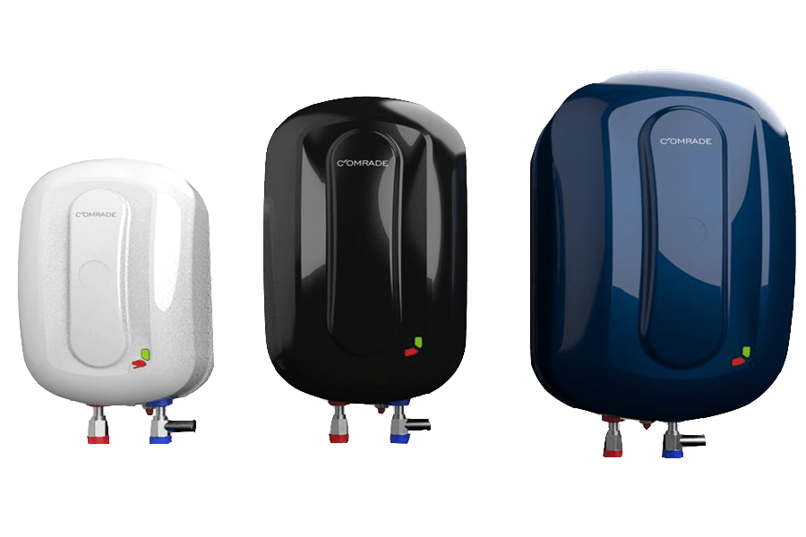
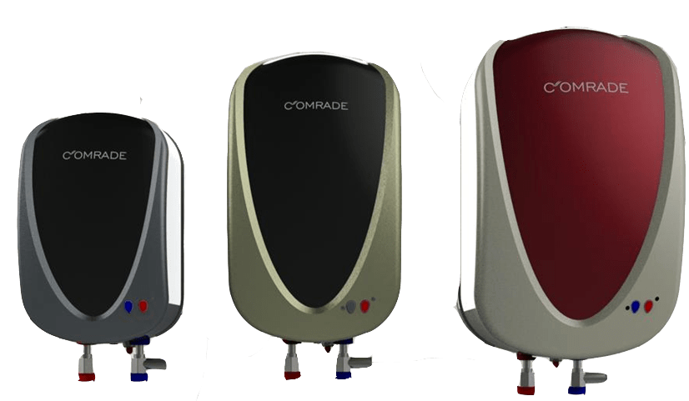
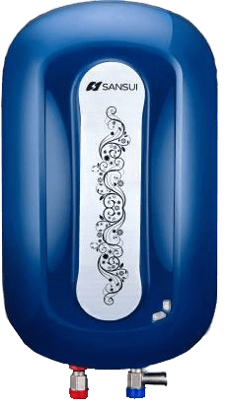
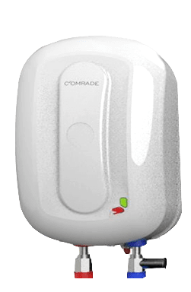
OEM Showcase
BACK TO
PROUCT RANGE

Slide 21
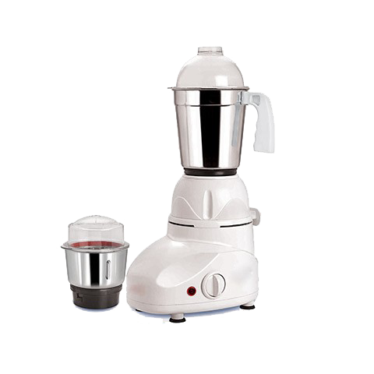
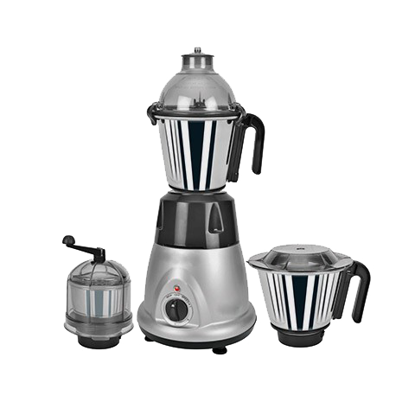
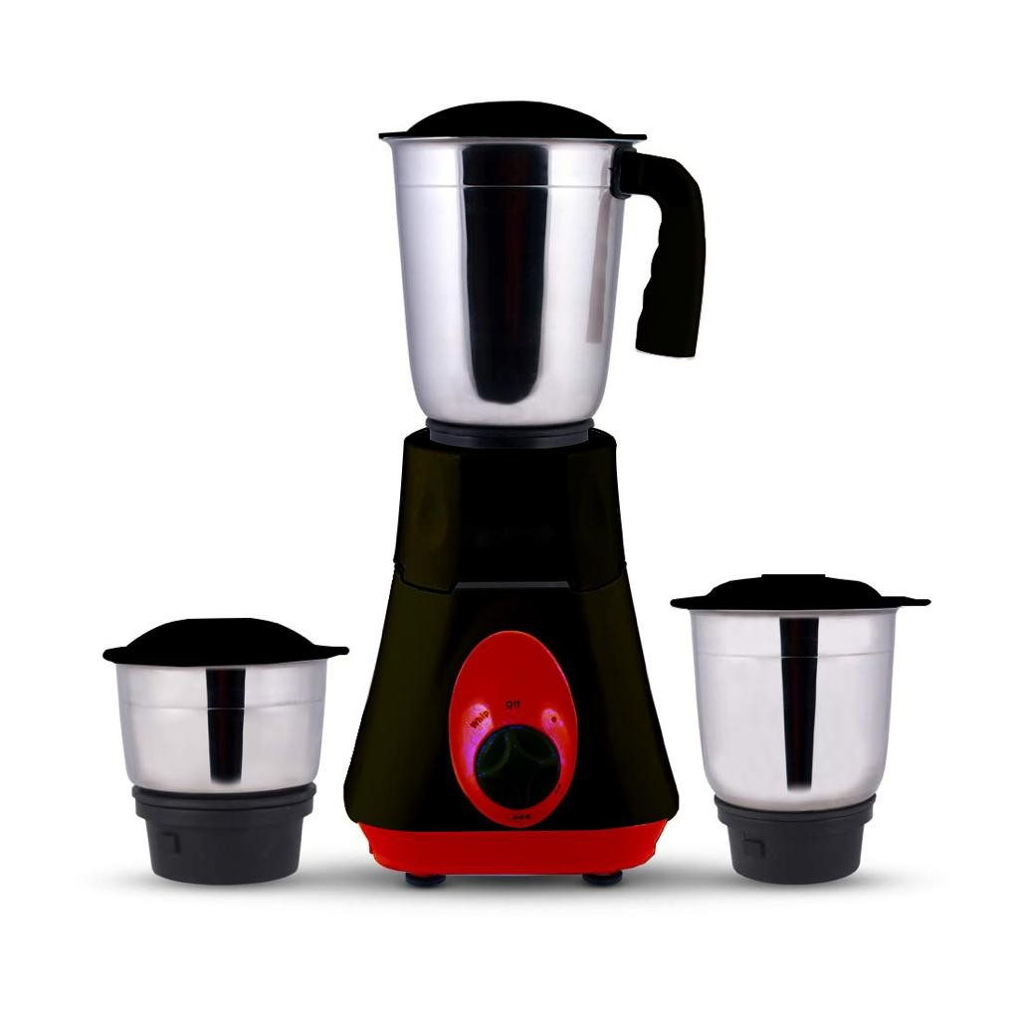
UPCOMING PRODUCT
Future Products
Mixer Grinder
Glass Stove

Slide 22
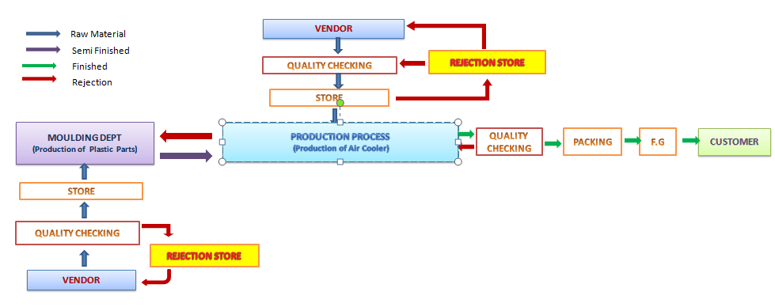
Activities Work Flow

Slide 23
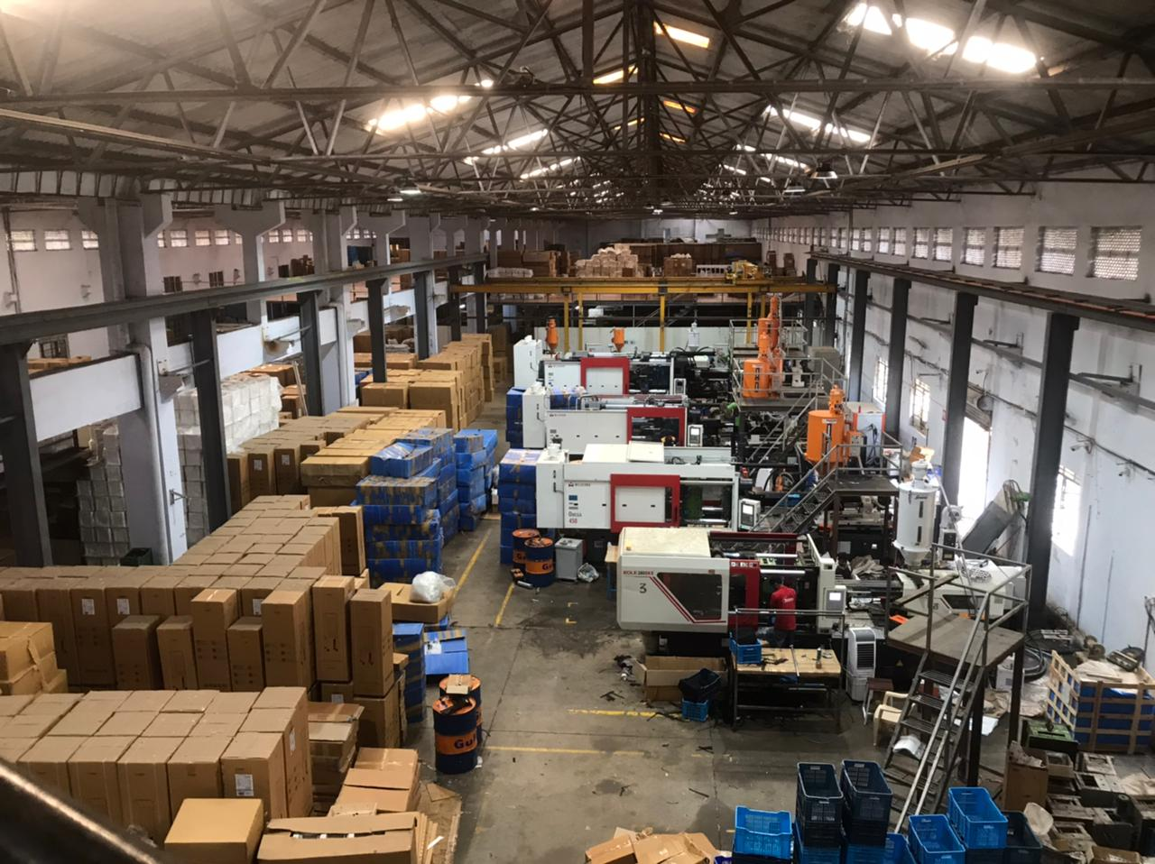
Production & Plant
We have Moulding Unit Setup under same roof with 08 Brand New Milacron Moulding Machines.
100 Tons 03 Machines
170 Tons
280 Tons
450 Tons
550 Tons
910 Tons

Slide 24
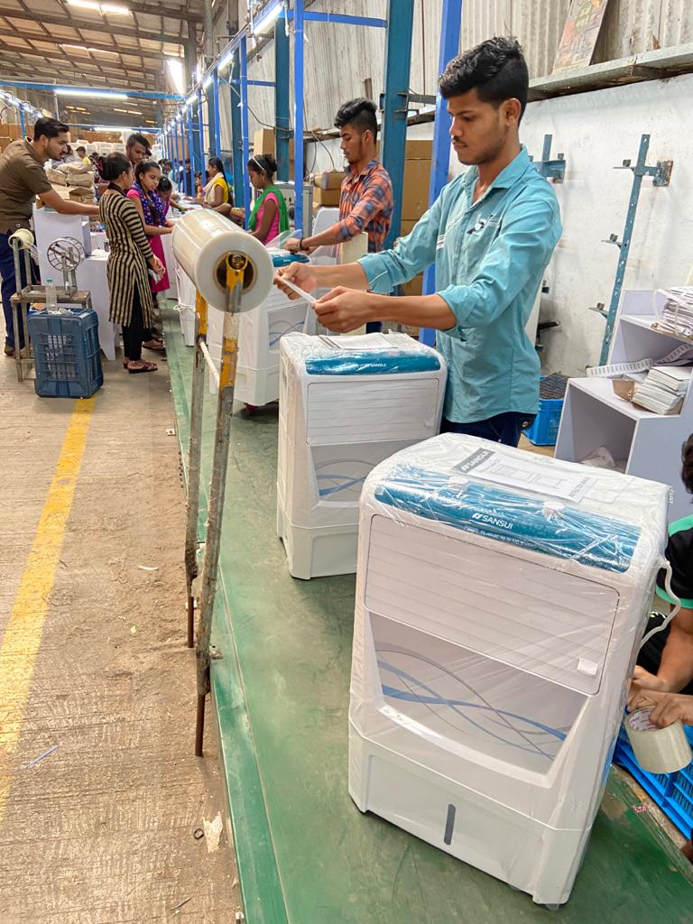
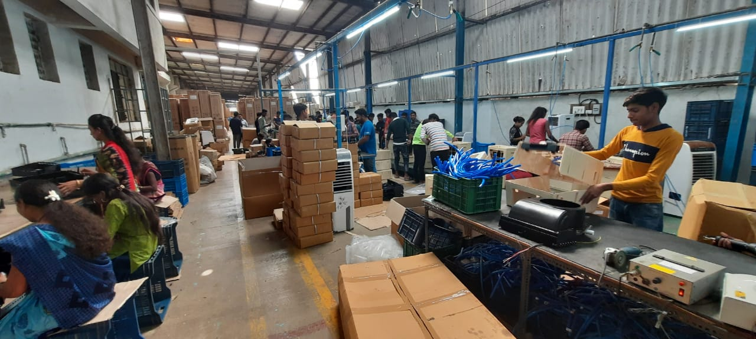
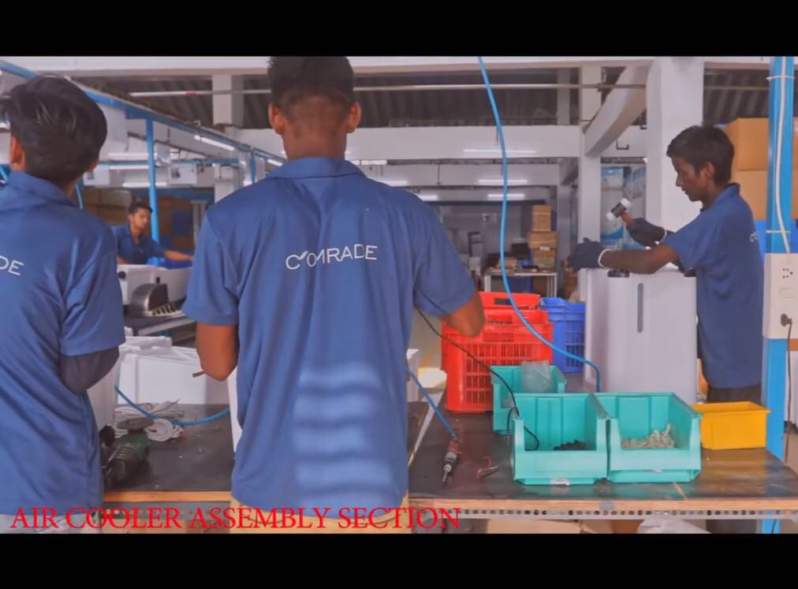
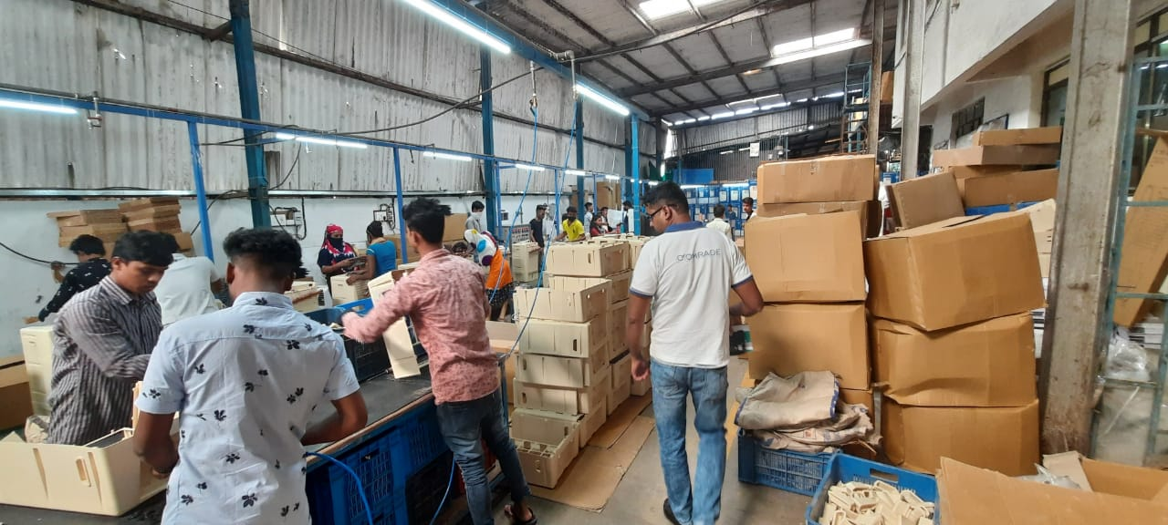
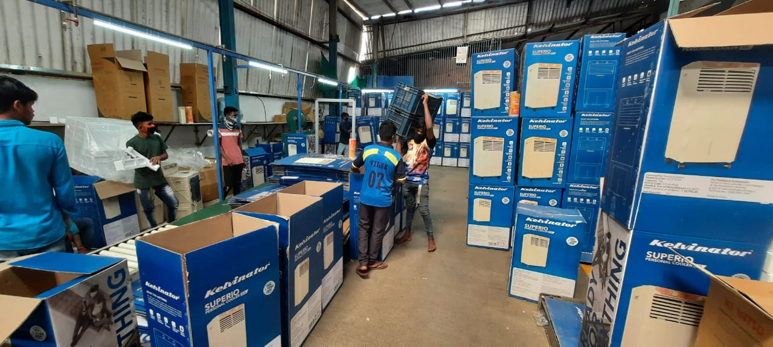
Assembly Line
We have total 4 Conveyor Assembly Line for fast production currently per day capacity of producing 1500 Air Cooler, 500 Water Heater & 600 RO Booster Pump which can be increase depending upon the requirement.

Slide 25
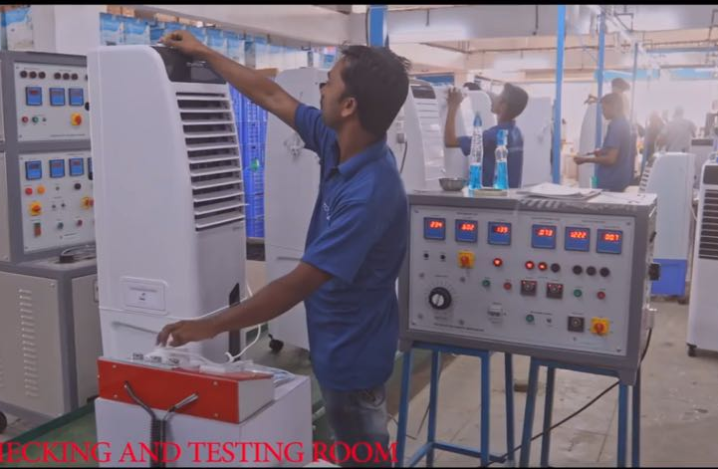
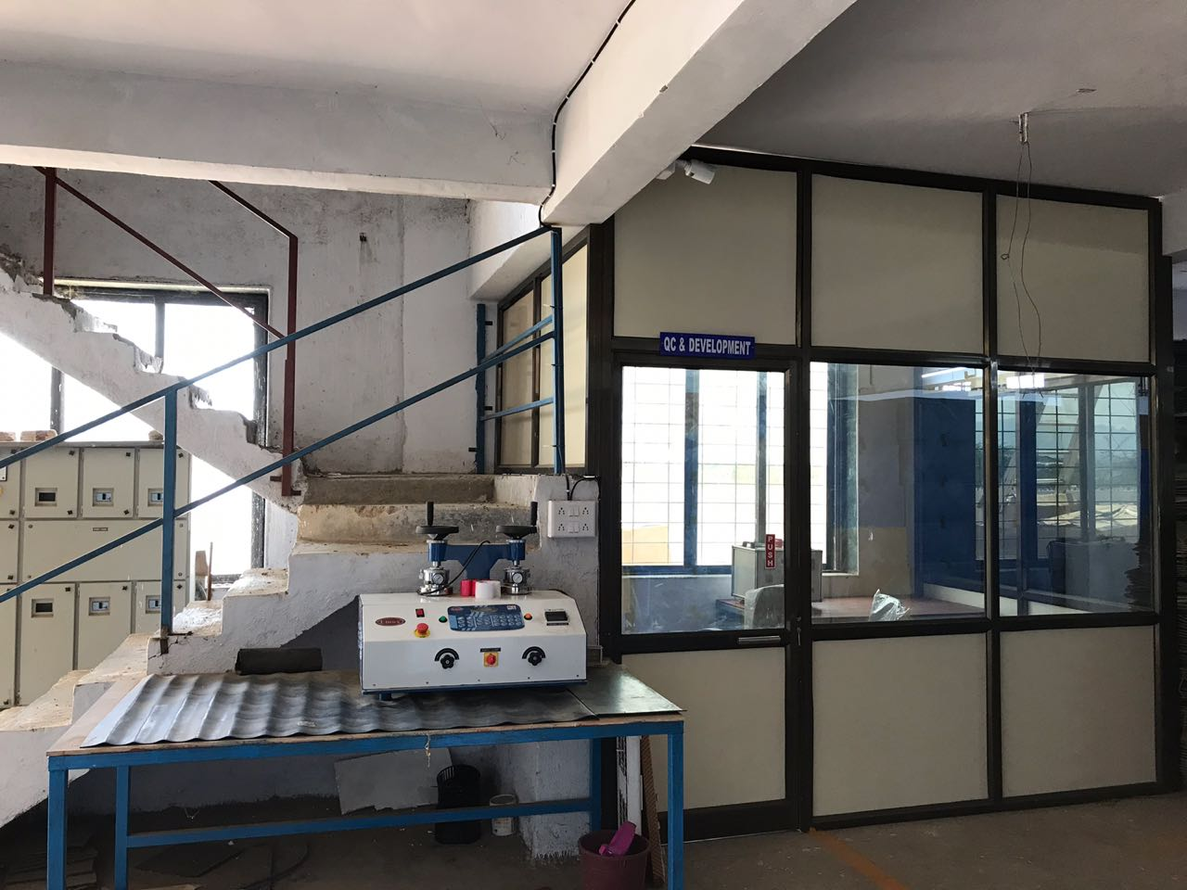
R & D Department
New Products Research : Well developed R & D Department conducts a thorough study for new product research.
Our R & D department ensures good design with best specification and a functional product that customers want to use.
New Product Development & existing product update.
Quality check & innovation.

Slide 26
PRESENT VALUED OEM CUSTOMERS
This is our OEM valued Customers
Domestic with international

Slide 27
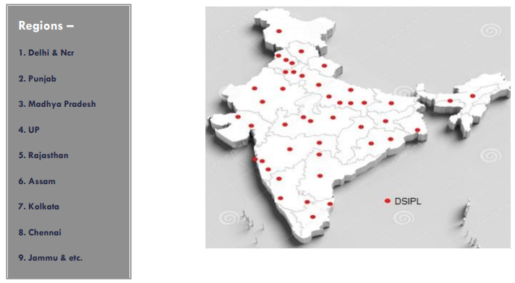
SERVICE NETWORK
Customer care (Toll Free Number)
Mon to Sat (Time 10:00 AM to 7 PM)

Slide 28
FACTORY TOUR
Our Factory located at 365, Nandore Village
Nandore Road, Palghar East,
Dist Palghar , Maharashtra -401404
we have space Approx. Area around 90000 sq. ft.,
Having Enough Space for moving Container
Vehicles
We have green & Clean environment

Slide 29
FINISHED GOODS AREA
FG Area Total 35000 Sq Ft.
We have store Capacity of 10000 Air Coolers

Slide 30
Exit

